Slide 1

ERG3010 PROJEKT
118010220 HAOTIAN MA (马浩天)
118010224 YU MAO (毛宇)
118010335 Wei WU (吴畏)
118010416 SHIQI Zhang (张诗琪)

Slide 2
CONTENT
1. Project Background
4. Queries of relations for daily operation and activities
3. E-R diagram & normalization and construction of database
2. Analysis of entities and relations
5. SQL queries for data analysis

Slide 3

1. Project Background
Goal of the project
Database background and working environment of the project

Slide 4
1. Project Background
1.1 Goal of the project
To design and implement a database that can help achieve the business goals of a professional football consulting company that provides decision support for clubs and players.
This database should store both latest and historical information of players, clubs, and leagues. This database should also support a set of daily operations such as adding, updating, and deleting a player and/or a league.

Slide 5
1. Project Background
1.2 Working Environment:
DB system:
MySQL 8.0 + MySQL Workbench 8.0
2) Website
The website requires Python environment:
Python >= 3.7
flask 1.1.2
pymysql 0.9.3

Slide 6
2. Entities & Relations
Database design
Question 1 & 2
Further questions

Slide 7
2.1 Database design

Slide 8
2.1 Database Design
The program mainly divided the raw data into two tables:
“player”: the information about the players
“club”: the information about the club
“league”: the information about the league
“country/region”: the information about the country or region
The table (2)(3)(4) were connected with a player table: “player”

Slide 9
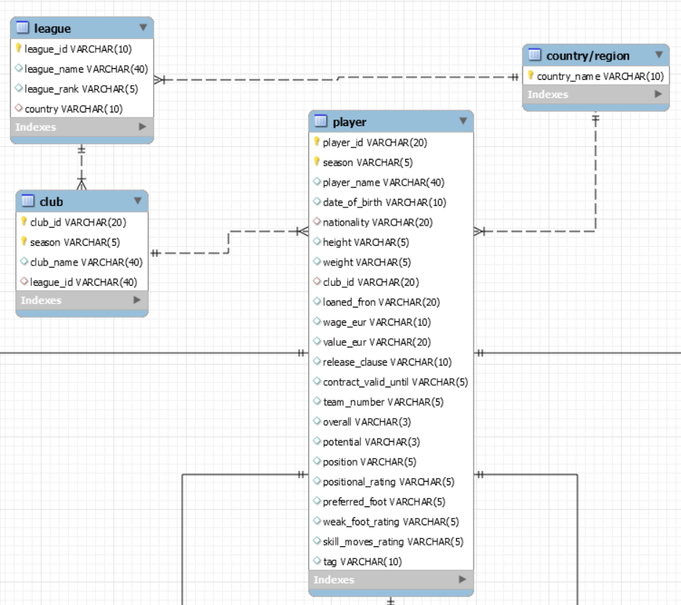
2.1 Database Design
League
Country/Region
Club
Player

Slide 10
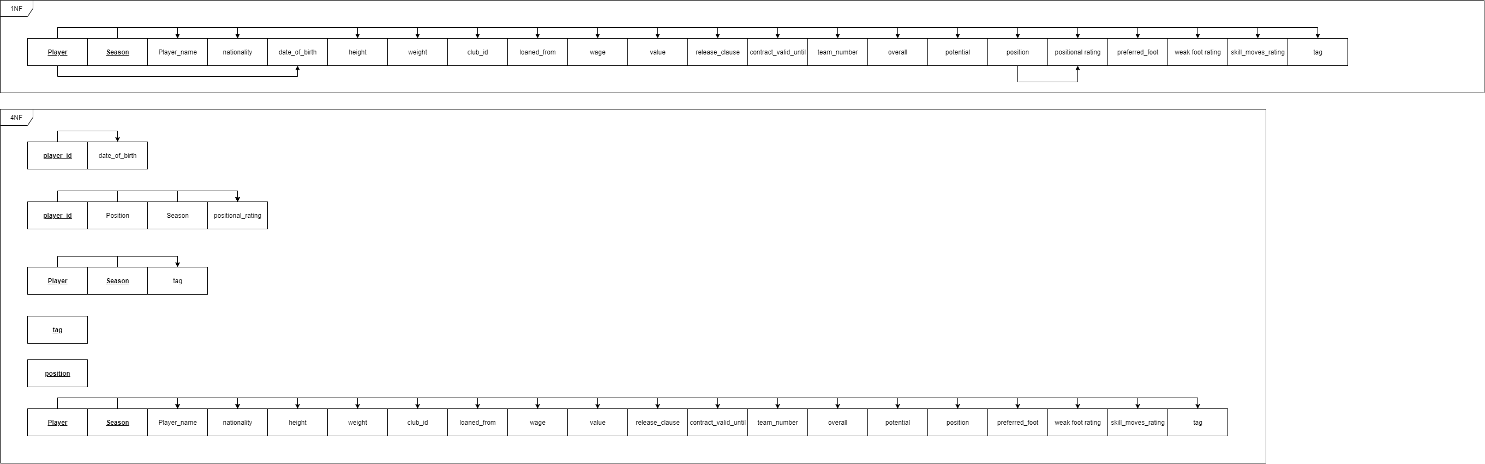
2.1 Database Design --Normalization

Slide 11
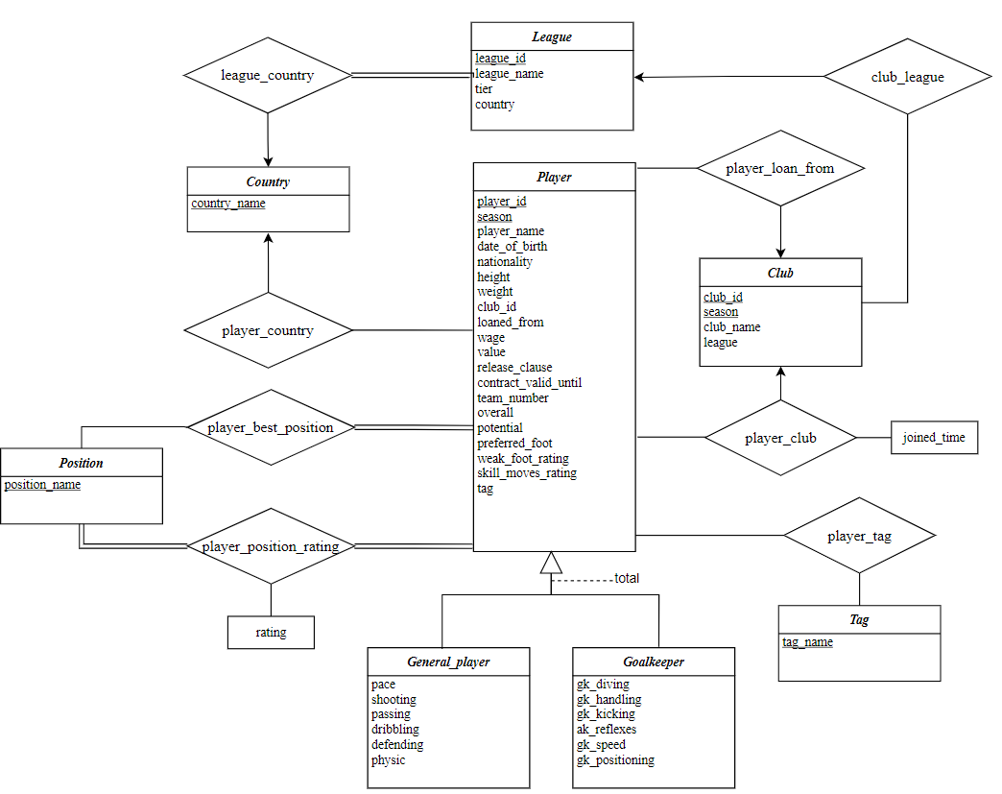
2.1 Database Design

Slide 12
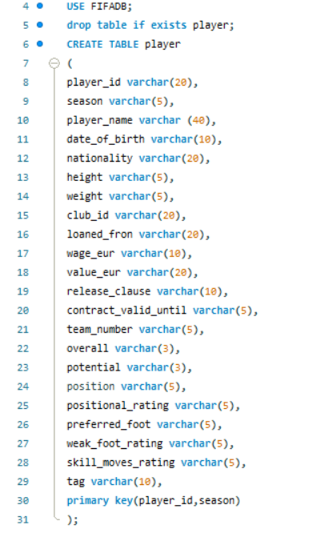
2.1 Database Design
MySQL Code:
2. Construct all the tables of the ERD and import data to them.
Step2_Construction.sql

Slide 13
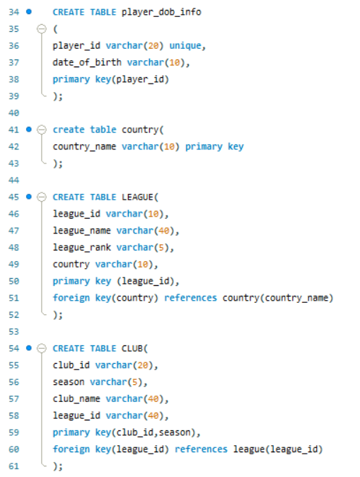
2.1 Database Design
MySQL Code:
3. Set primary keys and foreign keys for each table.
Step3_Connection.sql

Slide 14
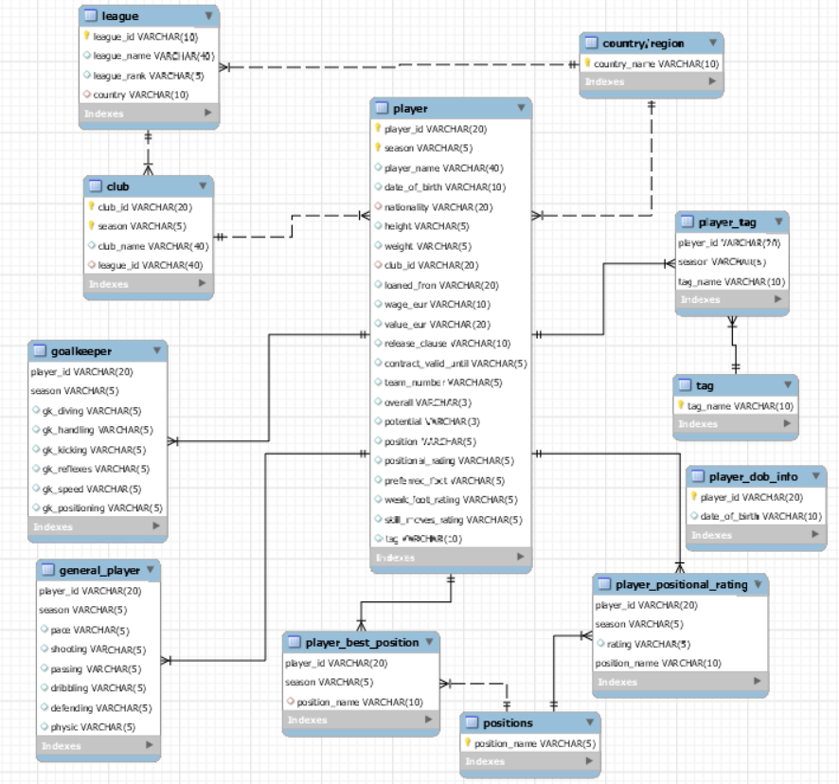
Generate the ERD:

Slide 15
2.2 Question 1

Slide 16
2.2 Question 1： To get the year for every state in US when the largest number of bridges were built in that state.
create table bridge_count as
SELECT STATE_CODE_001 as count_state, year_built_027 as count_year,count(*) as count
from rawdata
group by year_built_027,state_code_001
having YEAR_BUILT_027!='';
select a.*
from bridge_count a inner join
(select count_state,max(count) count from bridge_count group by count_state)b
on a.count_state = b.count_state and a.count = b.count order by a.count_state;
In this section, we group count the newly created table, find the number of Bridges built in each state per year, and record as count.
In this section, we selected the number of years and data in each state with the most Bridges.

Slide 17
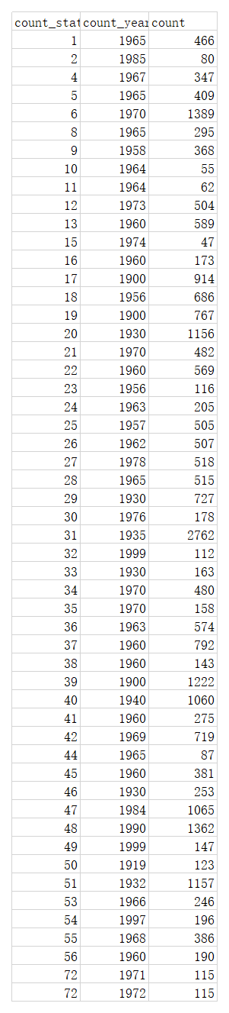
2.2 Question 1 Results

Slide 18
2.3 Question 2

Slide 19
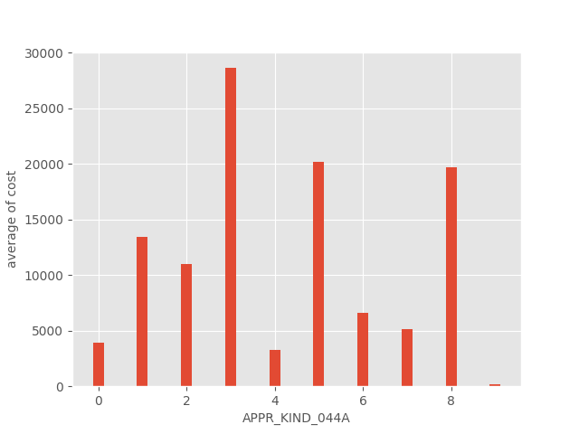
2.3 Question 2

Slide 20
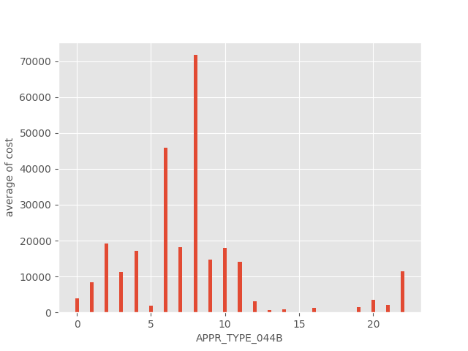
2.3 Question 2

Slide 21
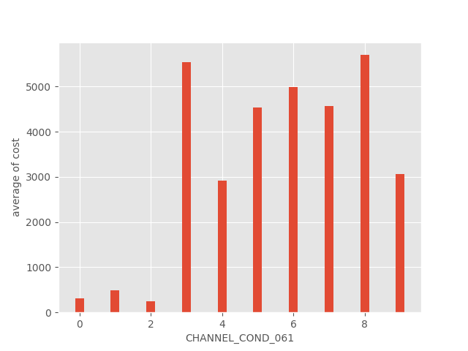
2.3 Question 2

Slide 22
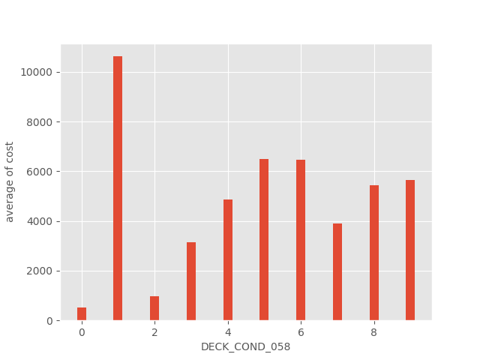
2.3 Question 2

Slide 23
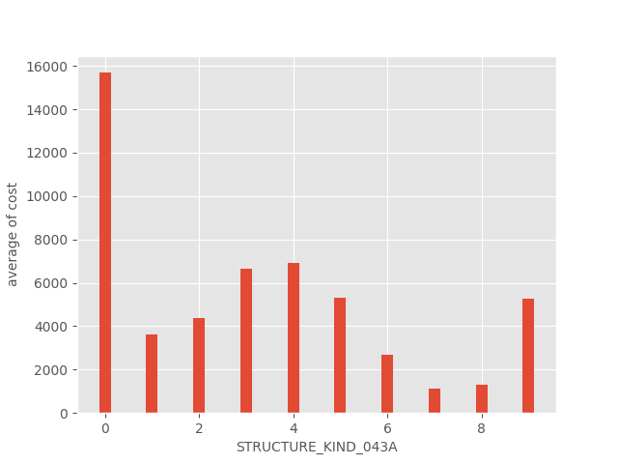
2.3 Question 2

Slide 24
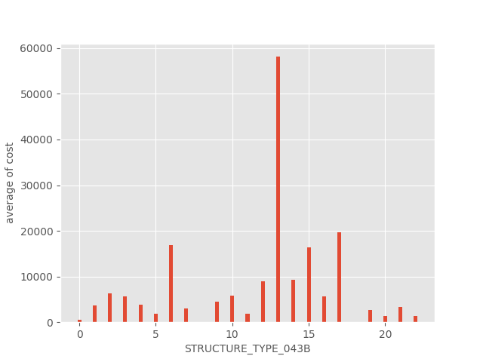
2.3 Question 2

Slide 25
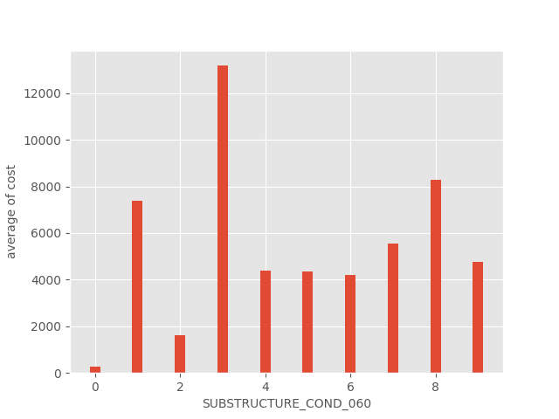
2.3 Question 2

Slide 26
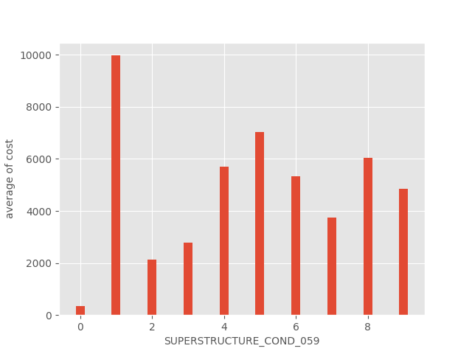
2.3 Question 2

Slide 27
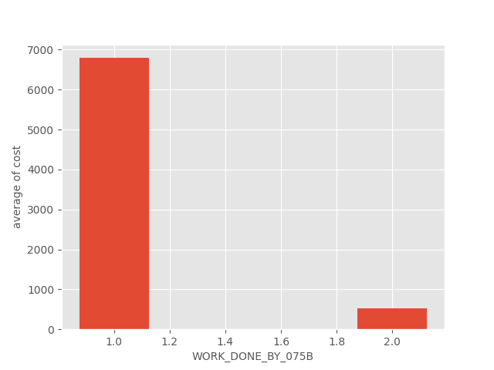
2.3 Question 2

Slide 28
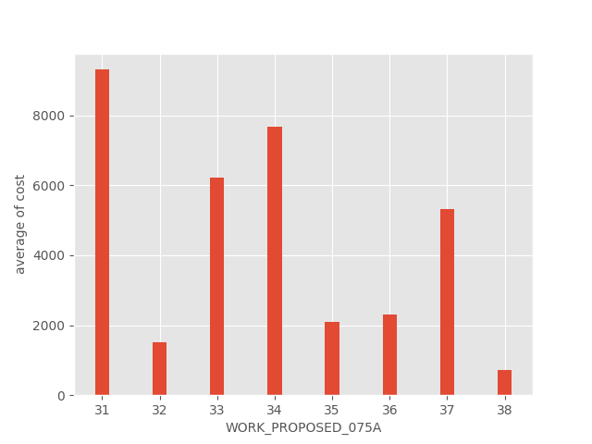
2.3 Question 2

Slide 29

4 Data Analysis
4.1 How does the total salaries of the BIG 6 clubs of English Premiere League change from season 14/15 to 20/21?
4.2 The rank of clubs in each of the "Big Five" European football leagues in terms of the total value of players in season 20/21.
4.3 A Comparison of the Big 3 Clubs of La Liga in Terms of Overall Ratings of Different Positions from Season 18/19 to 20/21.

Slide 30
2.4.1 How does the total salaries of the BIG 6 clubs of English Premiere League change from season 14/15 to 20/21?
Generally,
Highest total wage:
Manchester City
Lowest total wage:
Tottenham Hotspur (14-18)
Arsenal (18-21)
16/17 to 19/20:
The total wage of Arsenal dropped significantly from about € 3.1m to 2m.
14/15 to 20/21:
Manchester City, Liverpool, and Tottenham Hotspur had an upward trend in total wage.

Slide 31
2.4.1 The rank of clubs in each of the "Big Five" European football leagues in terms of the total value of players in season 20/21.

Slide 32
2.4.1 The rank of clubs in each of the "Big Five" European football leagues in terms of the total value of players in season 20/21.

Slide 33
2.4.1 The rank of clubs in each of the "Big Five" European football leagues in terms of the total value of players in season 20/21.

Slide 34
2.4.1 The rank of clubs in each of the "Big Five" European football leagues in terms of the total value of players in season 20/21.

Slide 35
2.4.1 The rank of clubs in each of the "Big Five" European football leagues in terms of the total value of players in season 20/21.

Slide 36
2.4.3 A Comparison of the Big 3 Clubs of La Liga in Terms of Overall Ratings of Different Positions from Season 18/19 to 20/21.
Read Madrid and FC Barcelona had close overall ratings, while Atlético Madrid had a lower overall rating.
In 19/20 and 20/21, Atlético Madrid’s ratings of defenders and midfielders were not far behind. However, its front line had a great disparity with the others.
The rating of defenders, midfielders and overall rating of Atlético Madrid showed an upward trend during the three seasons.

Slide 37
2.4.2 How Does Structure Kind Change over Time?

Slide 38
2.4.2 How Does Structure Kind Change over Time?
Design Load (Metric Unit)
Structure Kind Ratio
0 | Other
1 | Concrete
2 | Concrete continuous
3 | Steel
4 | Steel continuous
5 | Prestressed concrete
6 | Prestressed concrete continuous
7 | Wood or Timber
8 | Masonry
9 | Aluminum, Wrought Iron, or Cast Iron
Year

Slide 39
2.4.2 How Does Structure Type Change over Time?
Structure Type Ratio
Design Load (Metric Unit)
0 | Other
1 | Slab
2 | Stringer/Multi-beam or Girder
3 | Girder and Floorbeam System
4 | Tee Beam
5 | Box Beam or Girders - Multiple
6 | Box Beam or Girders - Single or Spread
7 | Frame (except frame culverts)
8 | Orthotropic
9 | Truss - Deck
10 | Truss - Thru
11 | Arch - Deck
12 | Arch - Thru
13 | Suspension
14 | Stayed Girder
15 | Movable - Lift
16 | Movable - Bascule
17 | Movable - Swing
18 | Tunnel
19 | Culvert (includes frame culverts)
20 | Mixed types
21 | Segmental Box Girder
22 | Channel Beam
Year

Slide 40
2.4.3 Is design load correlated with structure type and design type?

Slide 41
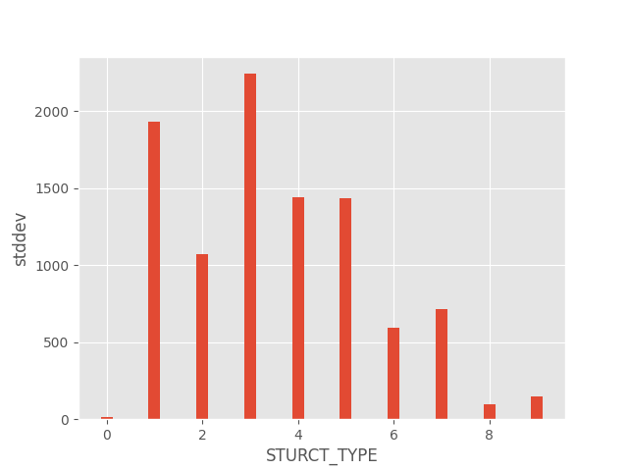
2.4.3.a design load vs structure type

Slide 42
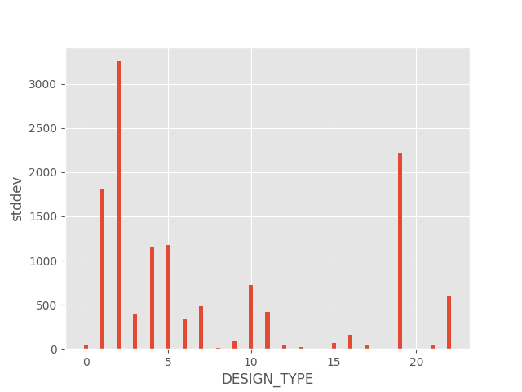
2.4.3.b design load vs design type

Slide 43
3. Further work
Website

Slide 44
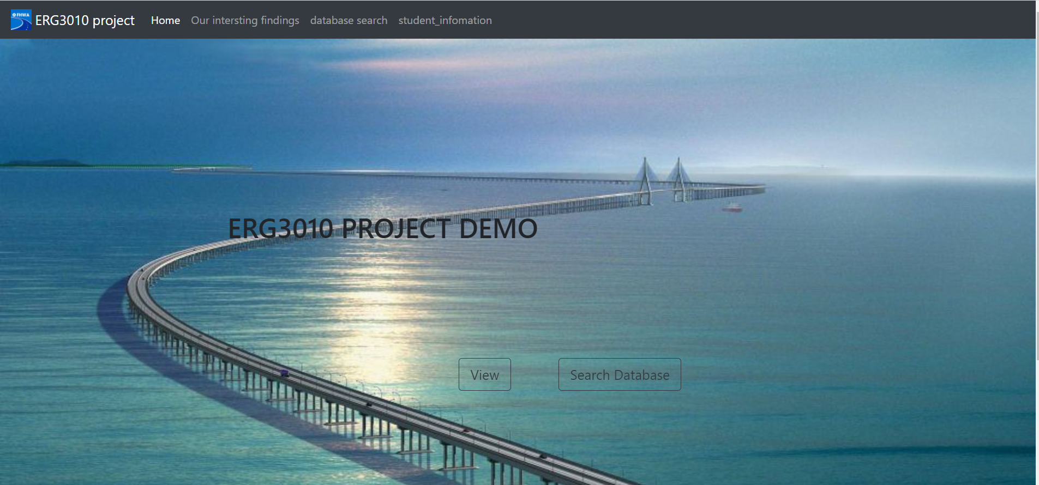
3. Website
pymysql
Flask
local mysql database

Slide 45
3. Website
How to run the website:
open the terminal in the folder of the website
type “python app.py” to run the program
open the link generated in the terminal by Chrome

Slide 46
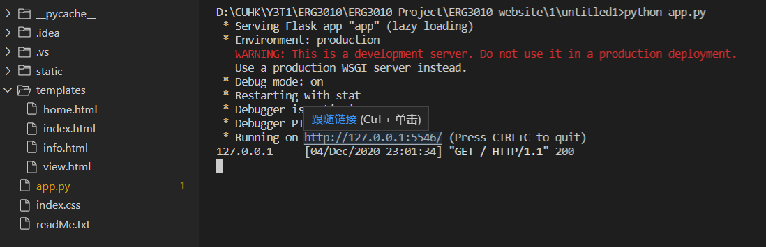

3. Website
1.
2.

Slide 47
3. Website
The search function is connected to the local MySQL database.
And a small table is created for the searching.

Slide 48
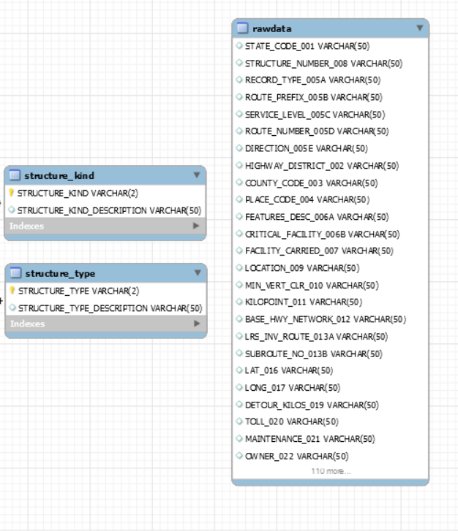
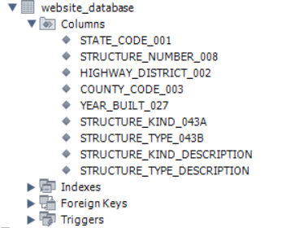
3. Website
a small table is created for the searching

Slide 49
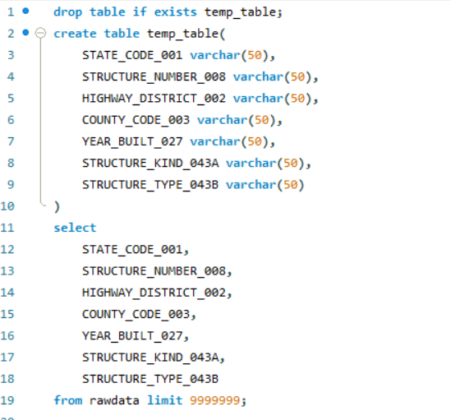
3. Website
create intermediate table_1
holding the attributes in “rawdata”
Step8_Website_database.sql

Slide 50
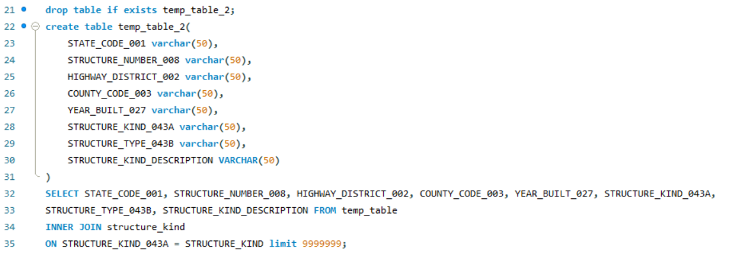
3. Website
Inner join & create intermediate table_2
holding the attributes in
1.“rawdata”
2.“structure_kind”
Step8_Website_database.sql

Slide 51
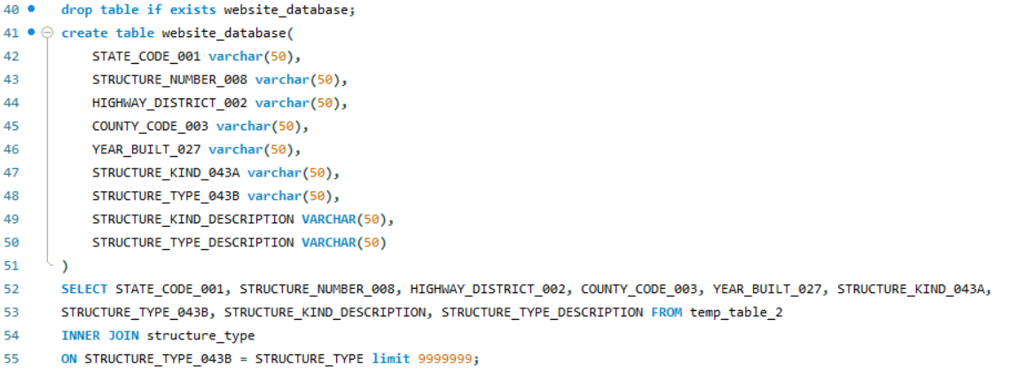
3. Website
Inner join & create target table webstite_database
holding the attributes in
1.“rawdata”
2.“structure_kind”
3.“structure_type”
Step8_Website_database.sql

Slide 52
4. Performance evaluation
Creating Indexes and small tables
PCC Algorithm

Slide 53
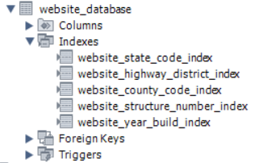
4.1 Creating Indexes and small tables
To improve the searching speed of the website:
a small table “website_database” is created.
some indexes are added to this table.

Slide 54


4.1 Creating Indexes and small tables
Searching speed test: (test in MySQL)
Test script:
Result:

Slide 55
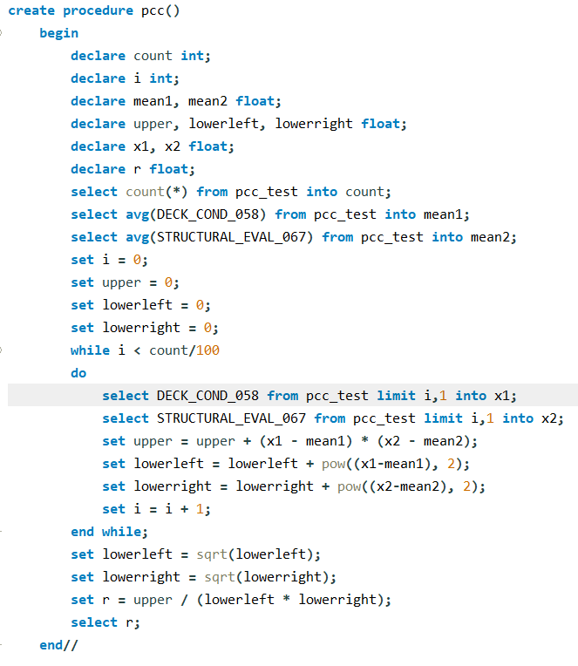
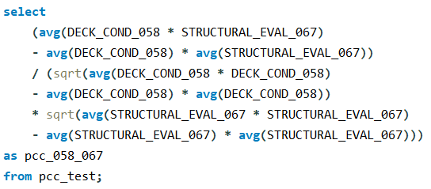
4.2 PCC Algorithm
PCC Algorithm Using Loop
PCC Algorithm Without Loop

Slide 56
4.2 PCC Algorithm

Slide 57

4.2 PCC Algorithm
PCC Algorithm Using Loop
Result (for 1% of the data)

Slide 58

4.2 PCC Algorithm
PCC Algorithm Without Loop
Result (for all of the data)

Slide 59
5. Work assignments & distribution

Slide 60
References
Pictures:
ArtStation - Battlefield V: Rotterdam, Darko Pracic | Battlefield, Rotterdam, Terrain. Retrieved from https://www.google.com.hk/url?sa=i&url=https%3A%2F%2Fwww.pinterest.com%2Fpin%2F381046818470004498%2F&psig=AOvVaw3t9oF_-TVJCYbPW0Zg8JXd&ust=1607241921651000&source=images&cd=vfe&ved=0CA0QjhxqFwoTCKD6j--wtu0CFQAAAAAdAAAAABAD

